Slide 1
HCI Project
Project Participants
زياد إبراهيم عبد اللطيف عراقيب
مصطفى أحمد أبو اليزيد الصعيدي
محمد محمد رمضان شاهين

Slide 2
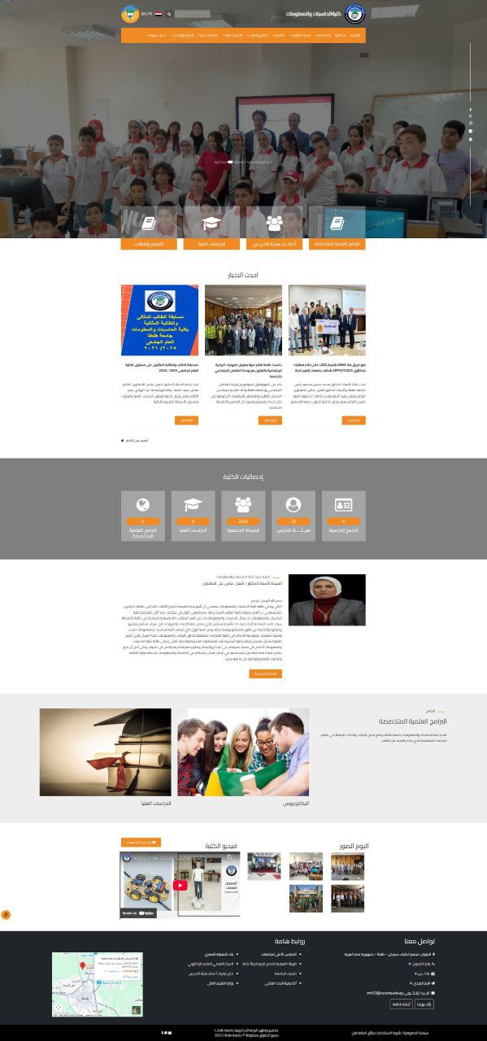








Cons of the Before Design
Outdated Appearance
Poor Readability
Hard to read
Old and dated look
Content Overload
Poor Organization
Too much content
Inadequate layout
Inconsistent Design
Weak Navigation
Inconsistent colors/fonts
Poor user experience
Not Mobile-Friendly
Unprofessional Image
No responsive design
Not modern college
Before Design - Old Educational Website

Slide 3
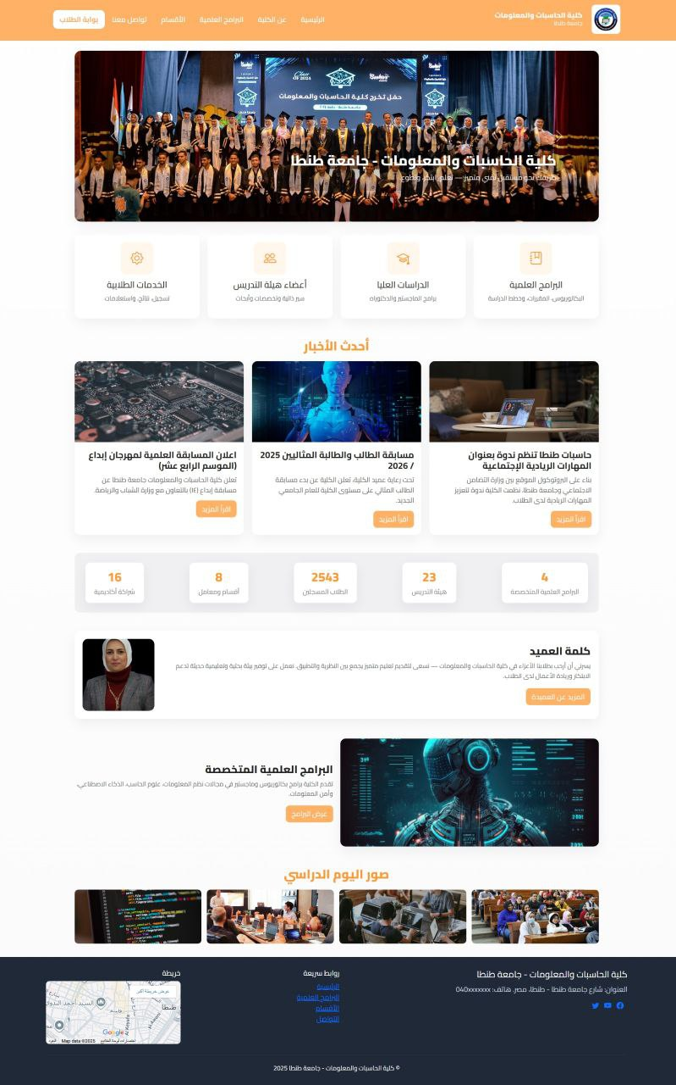








Pros of the After Design
Modern Design
User-Friendly
Clean and up-to-date
Easy to use and navigate
Organized Structure
Visual Consistency
Clear layout
Consistent colors/fonts
Enhanced Visuals
Responsive Design
Better images and graphics
Mobile-friendly
Strong Identity
Professional Appeal
Clear college branding
Attractive and well-designed
After Design - Modern Educational Website

Slide 4






Cons of the Before Design
Home Page Section
Non-Functional Click
Part of the home page with poor integration
Clickable image but does nothing
Missing Links
Poor User Experience
No connection to other pages
Frustrating interface with broken interactions
User Confusion
Before Design - Non-Functional Section
Users get confused by unclear functionality and navigation

Slide 5
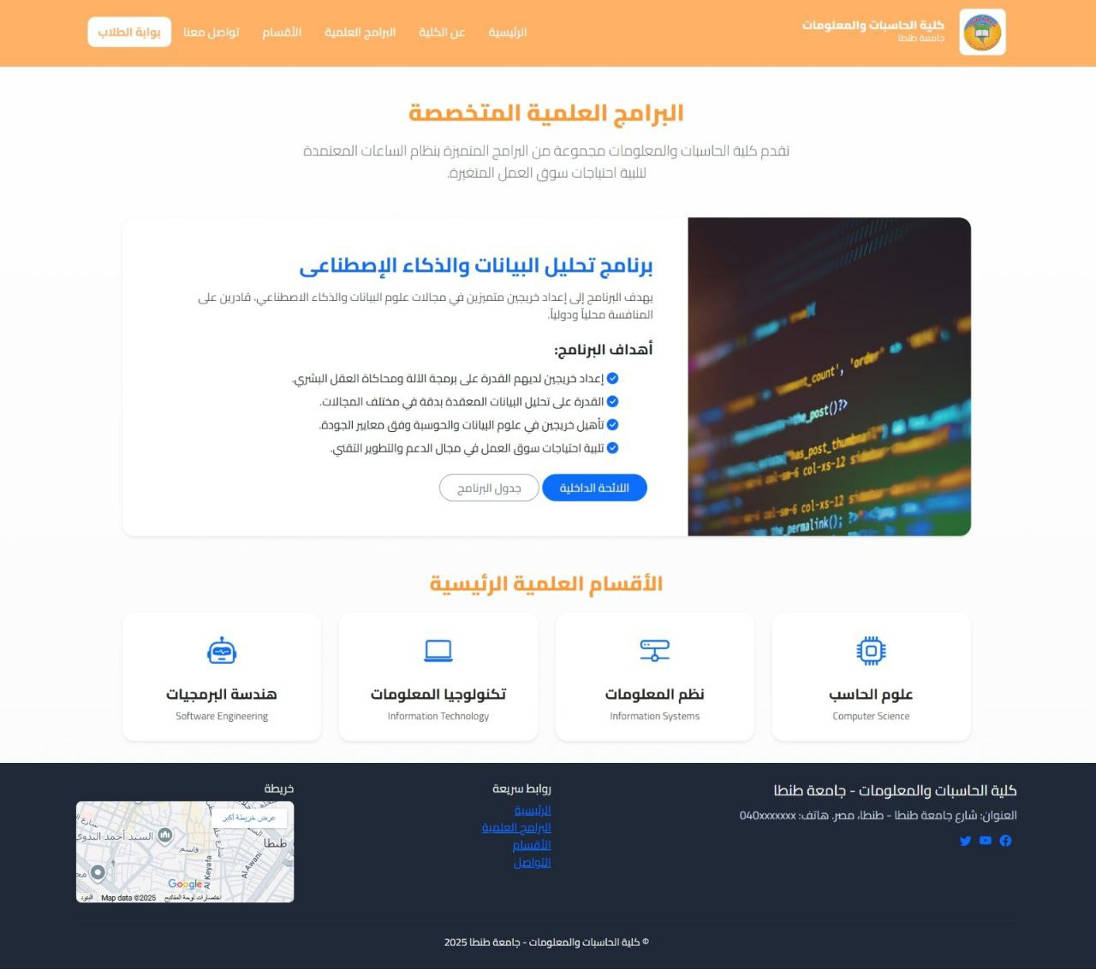





Pros of the After Design
Dedicated Page
Functional Links
Separate page for this section
Clickable images open new pages
Clear Navigation
Enhanced UX
Better user experience with smooth interactions
Intuitive structure with clear purpose
Easy Information Access
After Design - Functional Section
Simplified content discovery for users

Slide 6
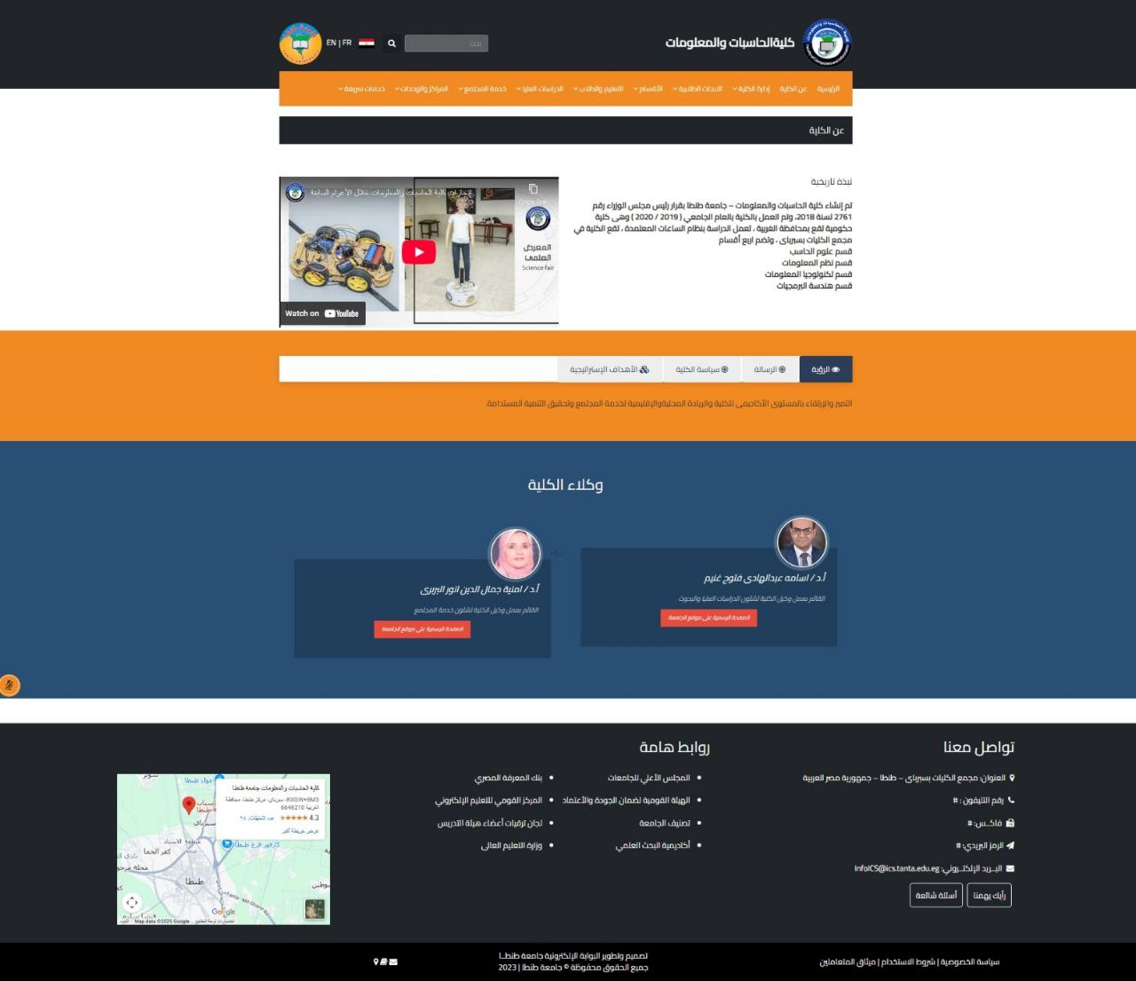





Before
Tiny Text
Hidden Content
Text is too small to read comfortably
Important information is not visible
Hidden Mission & Vision
Unclear Sections
Must click to see core content
Sections not visible or properly defined
Poor Contrast
Inconsistent Colors
Color contrast is insufficient
Background and text colors don't match
Before Design - Poor Visual Hierarchy

Slide 7
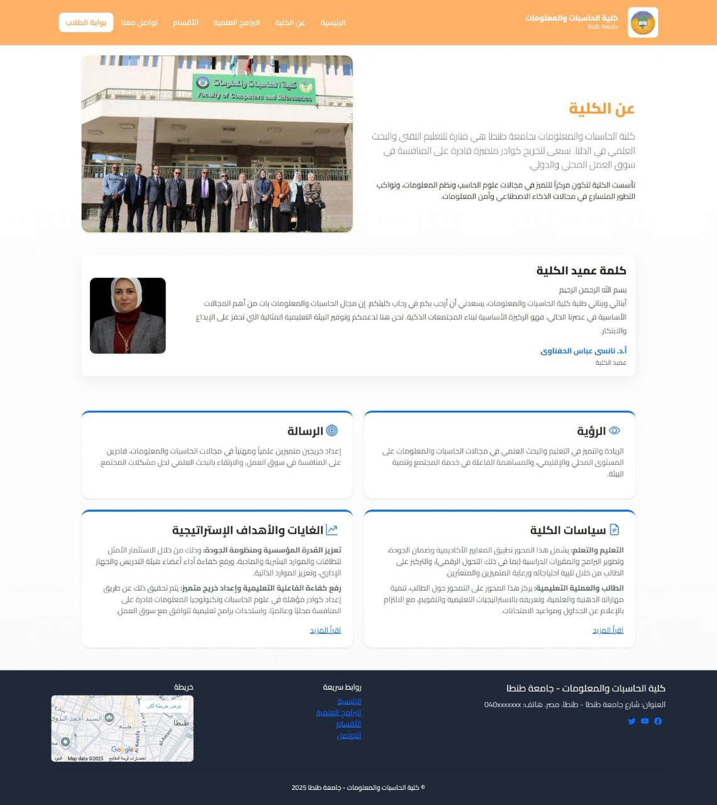





After
Visible Content
Clear Sections
All content clearly visible without extra clicks
Each part in defined sections with proper hierarchy
Readable Text
Better Contrast
Text is easy to read with proper sizing
Improved color contrast for better readability
Clean Colors
Better UX
Colors are clean and well-organized
Overall improved user experience
After Design - Improved Visual Hierarchy

Slide 8
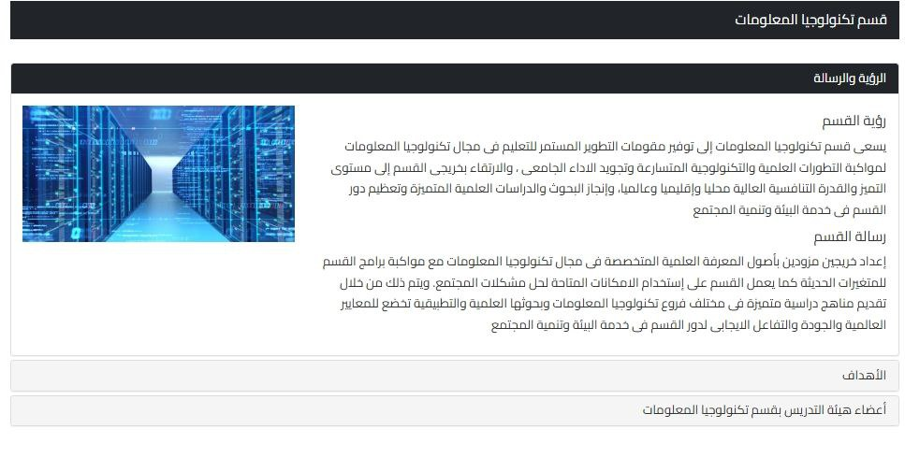
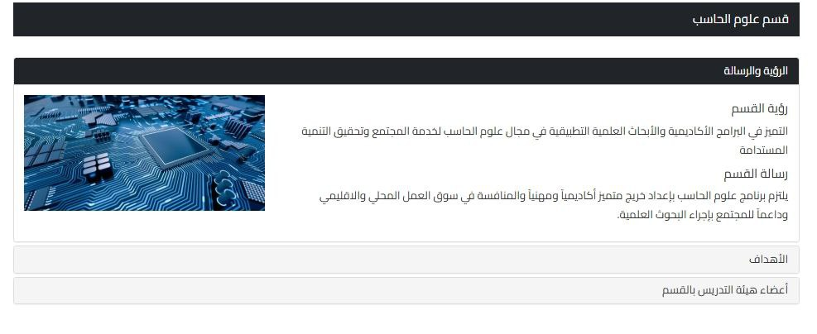


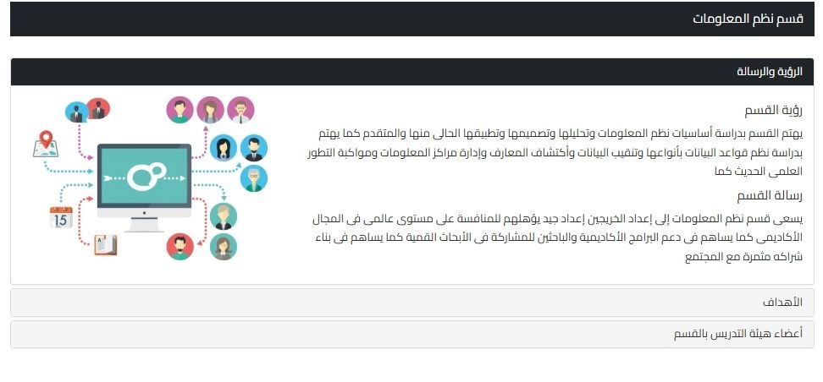
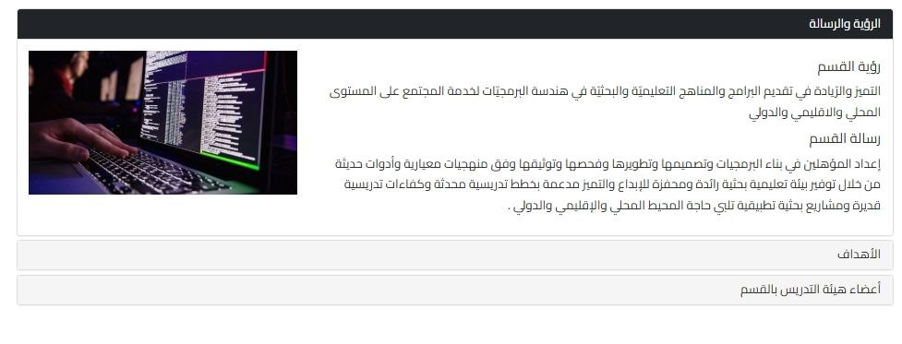


Before
Separate Pages
Inconsistent Colors
Each department on its own page
Lack of harmony across sections
Hard to Read
Old Font Style
Department Page 1
Department Page 2
Poor typography and spacing
Outdated typography choices
Hidden Text
Poor UX
Must click icons to see content
Frustrating user experience
Department Page 3
Department Page 4

Slide 9
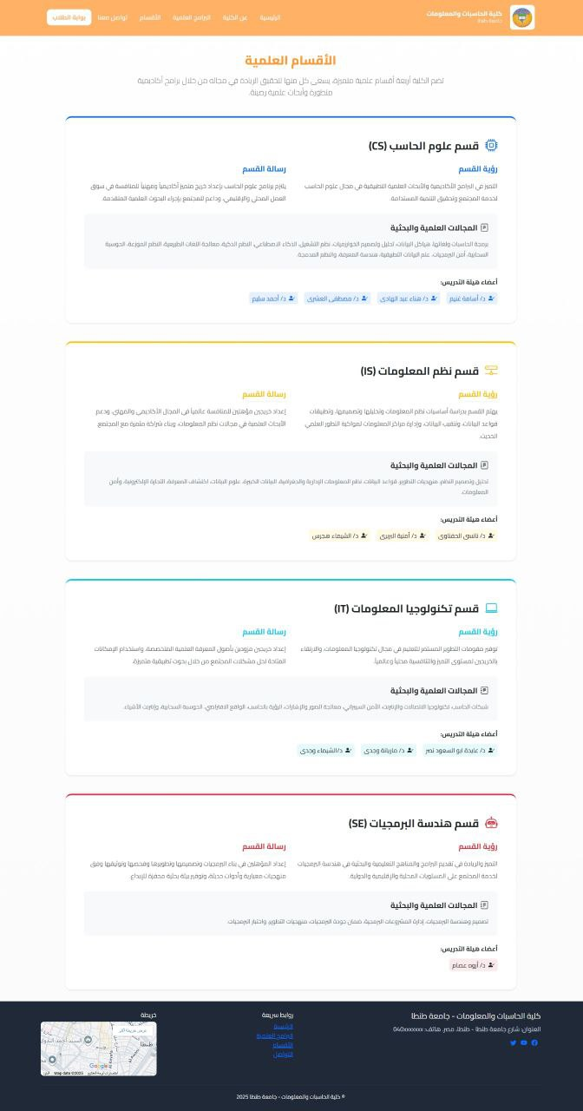



After
Unified Page
Clean Colors
All departments on one page
Consistent palette throughout
Readable Text
Modern Design
Easy to read content
Contemporary look and feel
Direct Access
Enhanced UX
No clicking needed to see content
Smoother experience for users
After Design - Unified Department Pages

Slide 10
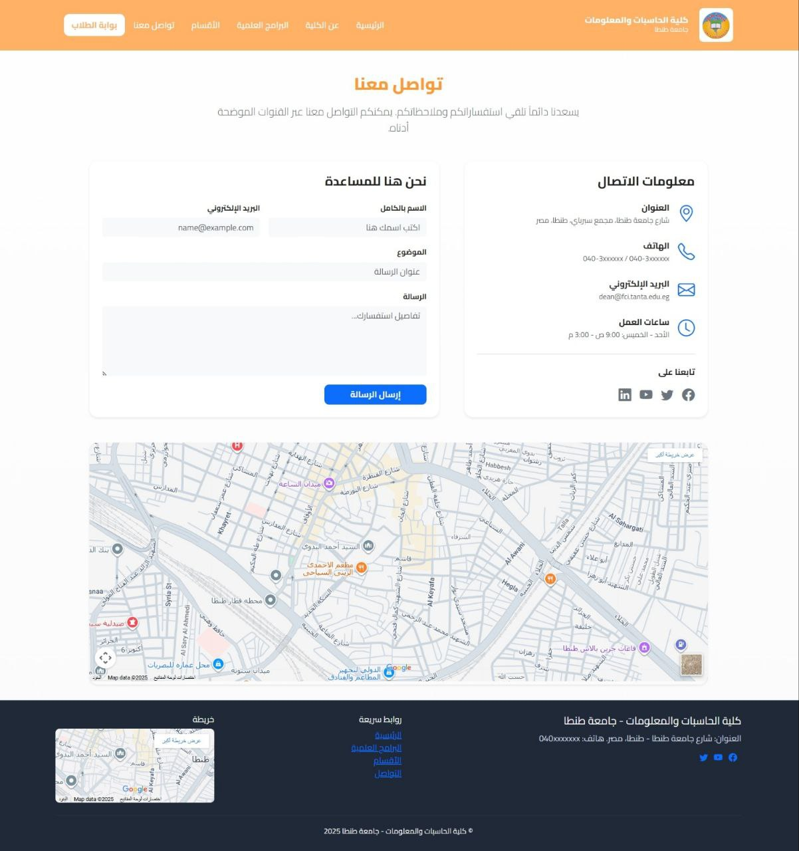






New Feature: Contact Us Page
New Addition
Dedicated Page
Did not exist before in previous design
New "Contact Us" section added
Easy Messaging
Clear Information
Users can send messages directly
Contact details clearly displayed
Map Integration
Enhanced Communication
Location shown with interactive map
Better user experience through improved contact
New Contact Us Page Design

Slide 11
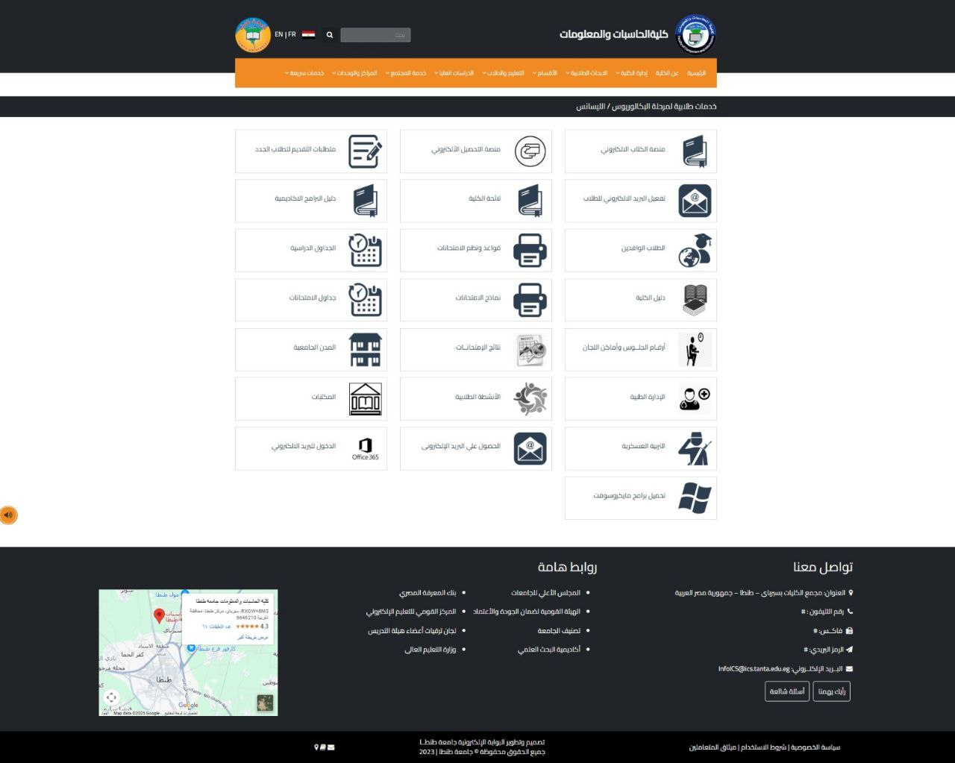



Old Student Services Page
Uniform Icons
No Visual Distinction
Same color and font for all icons
Services look identical without differentiation
Poor Readability
Disorganized Layout
Hard to read and scan content quickly
Poor structure with no clear hierarchy
Difficult Navigation
Old Student Services Page - Poor Visual Design
Users struggled to find the services they needed

Slide 12
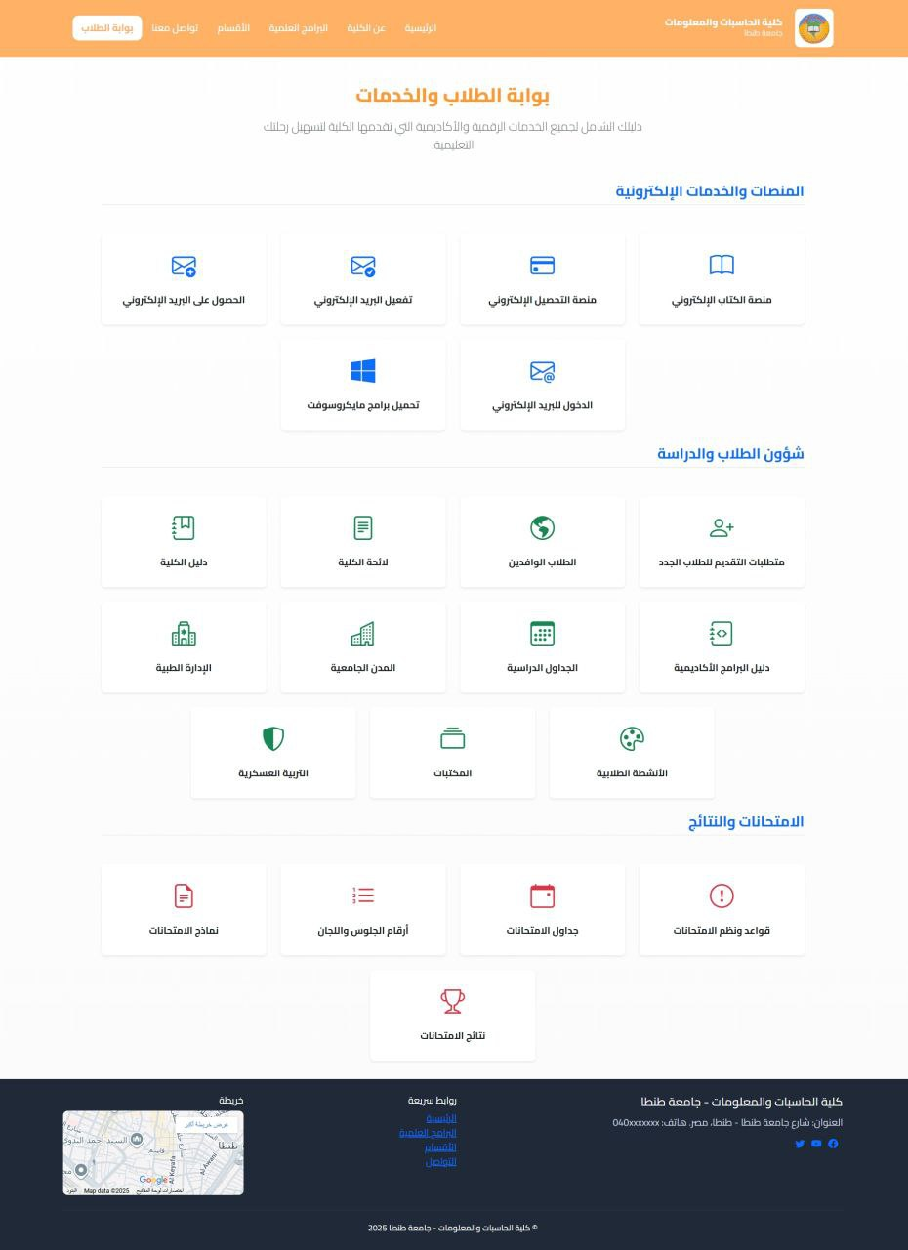



New Student Services Page
Categorized Services
Color Coding
Each group has a distinct color
Grouped by category for easy navigation
Clear Titles
Visual Consistency
Well-defined section headings
Better color and text harmony
Easy Discovery
Enhanced UX
Easier to find needed services
Improved user experience overall
New Student Services Page - Organized by Categories

Slide 13





Conclusion
Design Improvement
Clear Organization
Easier Navigation
Website design significantly enhanced
Pages clearer and better structured
Intuitive paths for users
Visual Consistency
New Features
Enhanced UX
Colors and layout more harmonious
Additional pages and functionality
Better overall user experience

Slide 14



Thank You
For reviewing our website redesign journey

